Slide 1

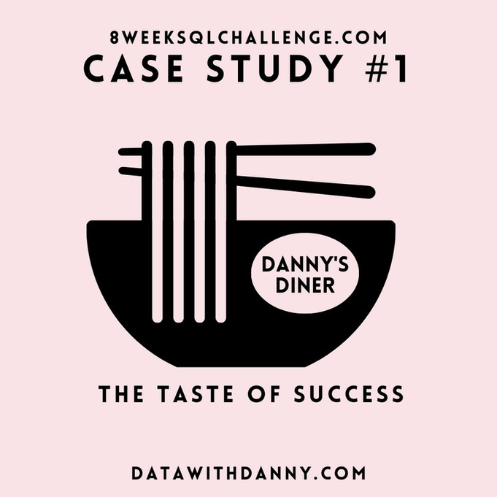

DATAWITHDANNY.COM
Case Study #1
Created by : Kiran Ambekar

Slide 2


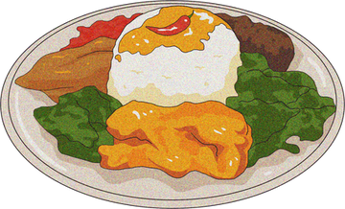
Introduction
Danny seriously loves Japanese food so in the beginning of 2021, he decides to embark upon a risky venture and opens up a cute little restaurant that sells his 3 favourite foods: sushi, curry and ramen.
Danny’s Diner is in need of your assistance to help the restaurant stay afloat - the restaurant has captured some very basic data from their few months of operation but have no idea how to use their data to help them run the business.

Slide 3
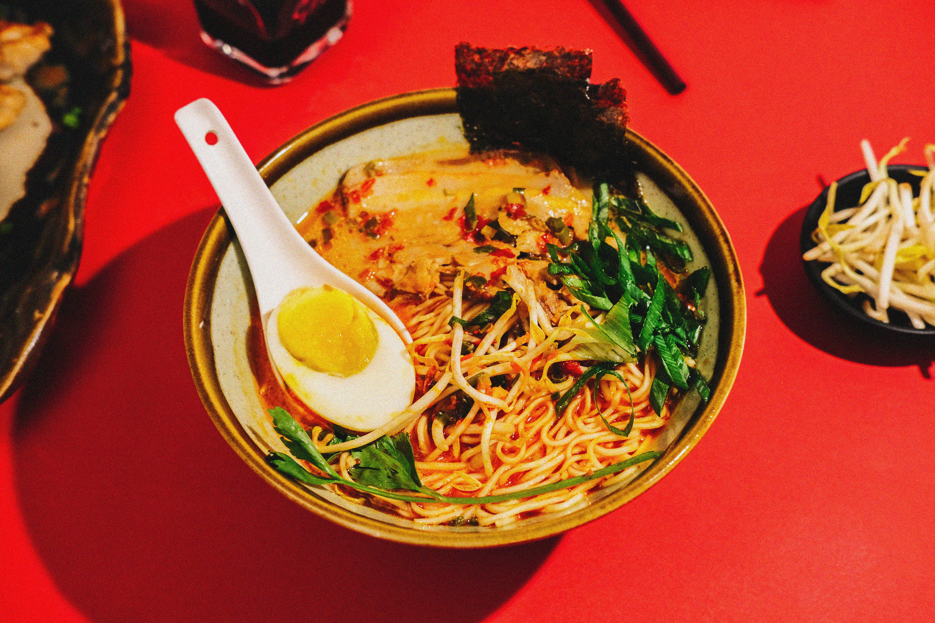
Problem Statement
Danny wants to use the data to answer a few simple questions about his customers,
especially about their visiting patterns, how much money they’ve spent and also which
menu items are their favourite. Having this deeper connection with his customers will help
him deliver a better and more personalised experience for his loyal customers.
He plans on using these insights to help him decide whether he should expand the existing
customer loyalty program - additionally he needs help to generate some basic datasets so his
team can easily inspect the data without needing to use SQL.
Danny has provided you with a sample of his overall customer data due to privacy issues - but he hopes that these examples are enough for you to write fully functioning SQL queries to help him answer his questions!

Slide 4
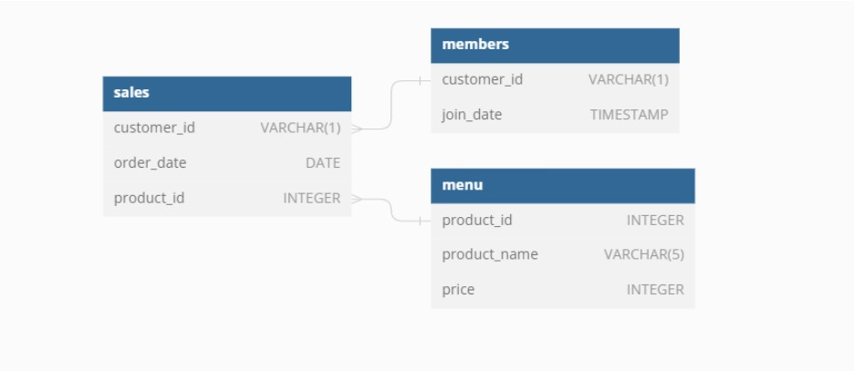
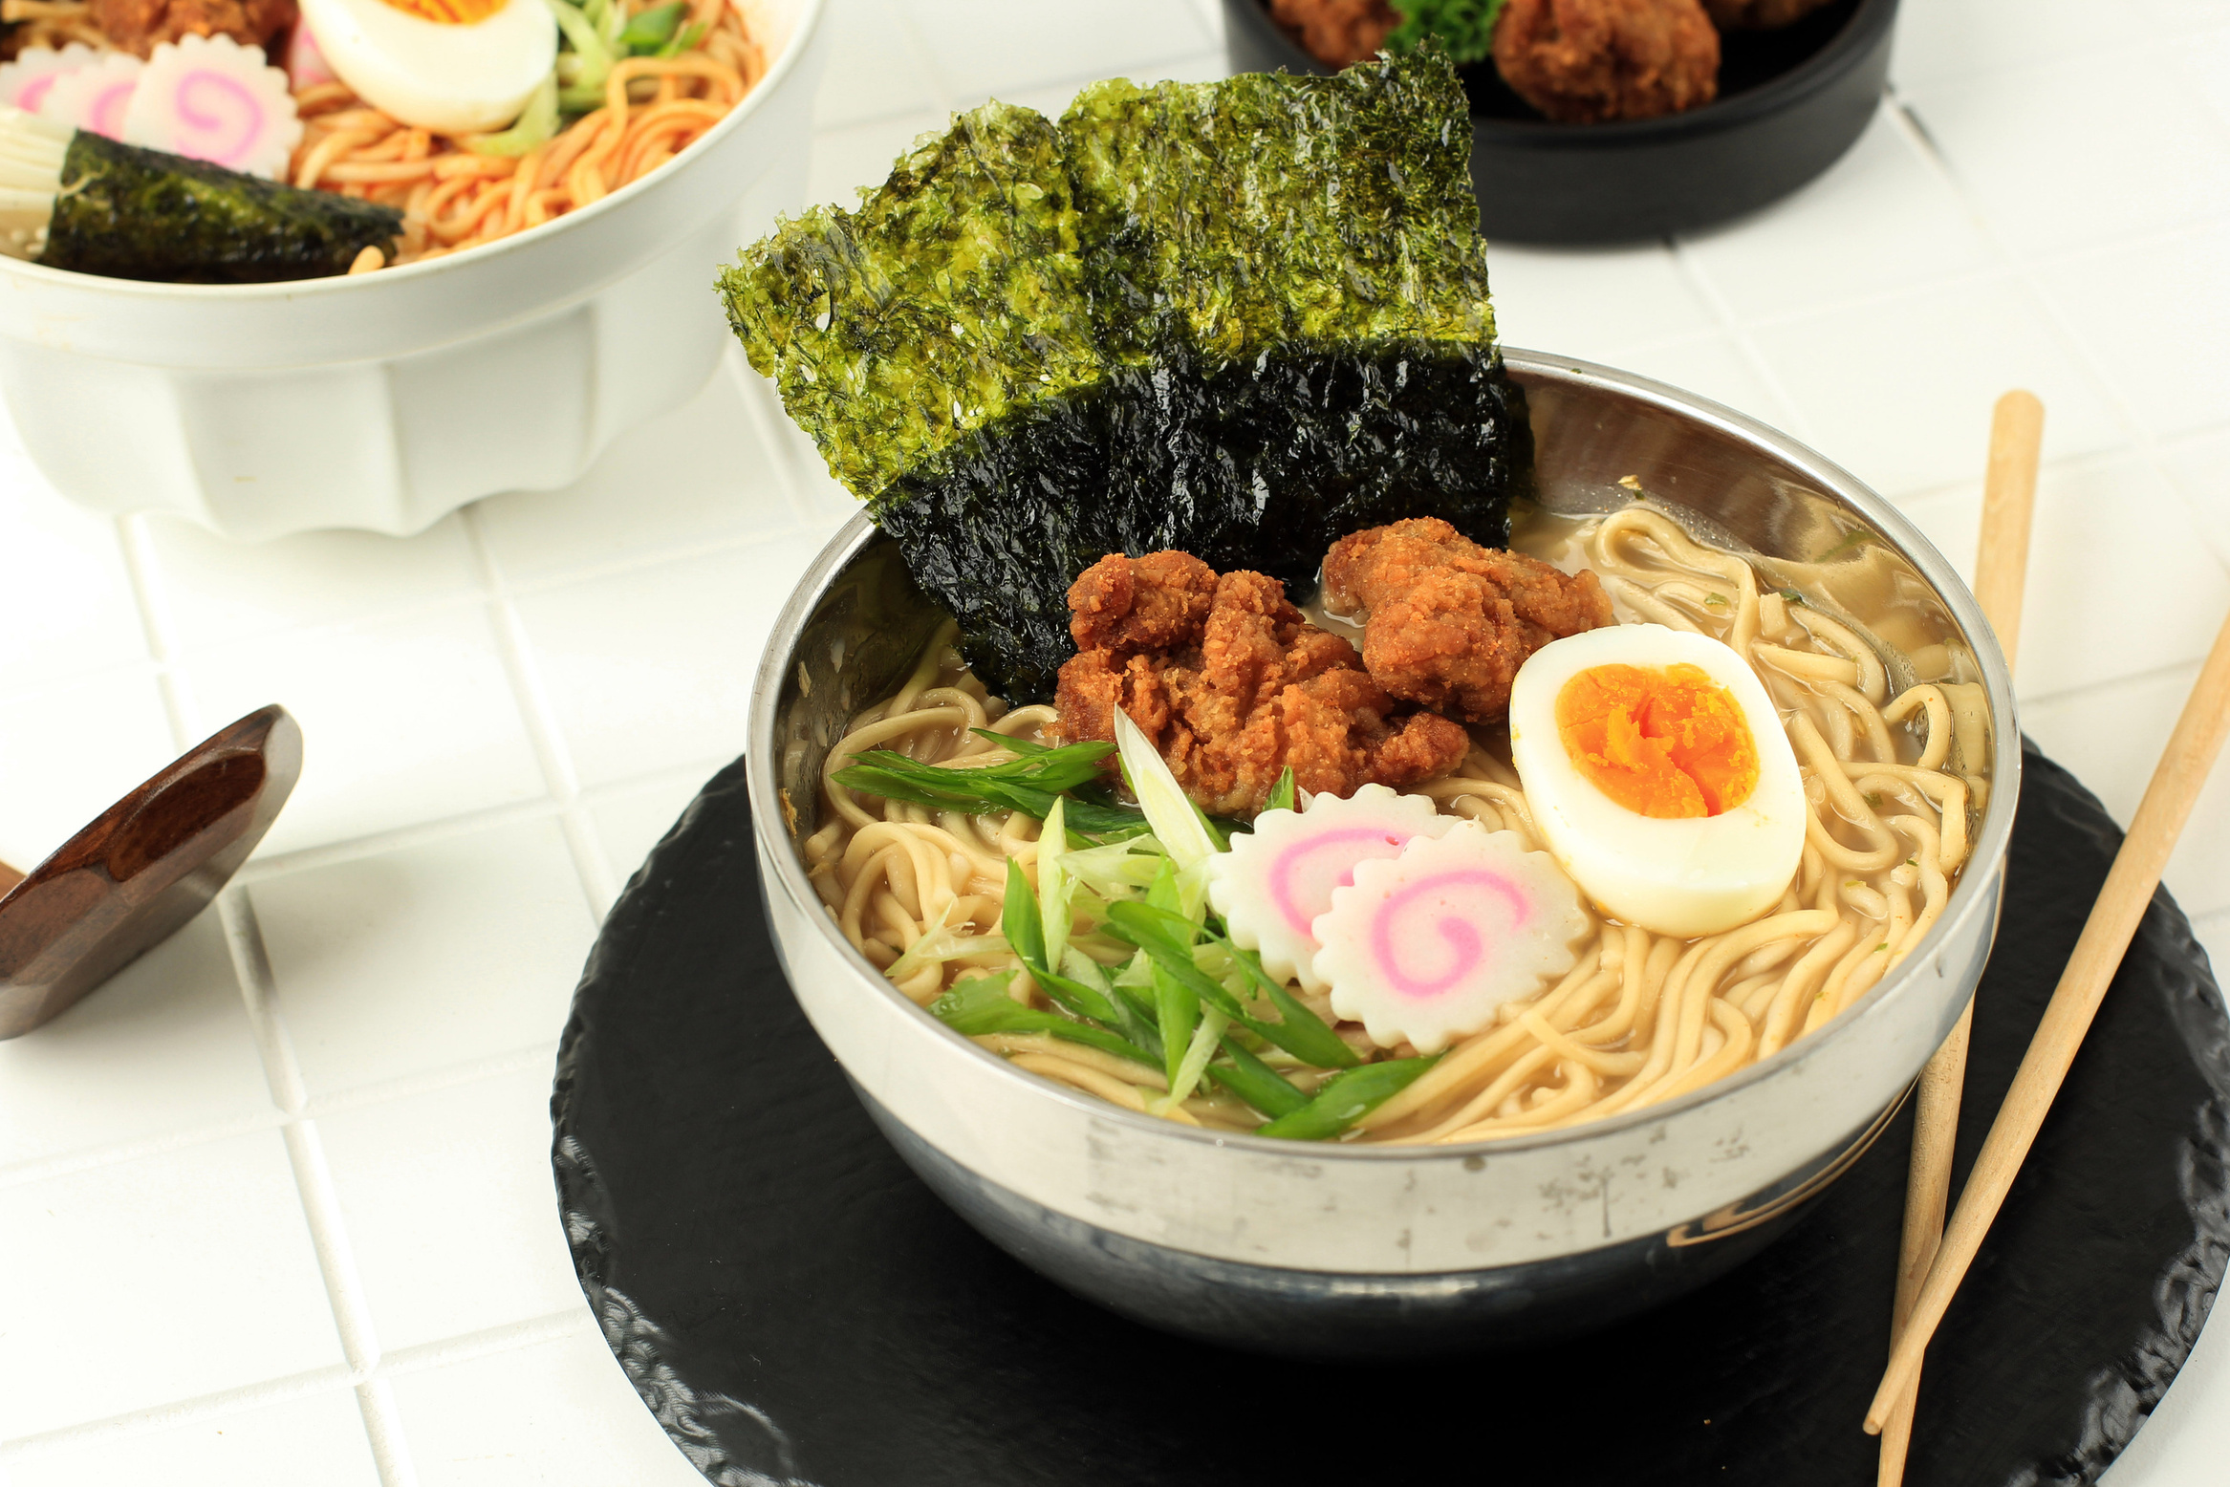
Entity Relationship Diagram

Slide 5
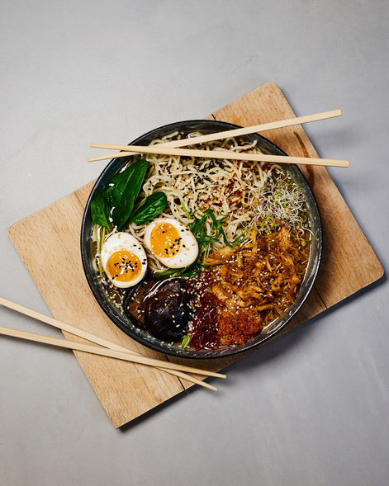
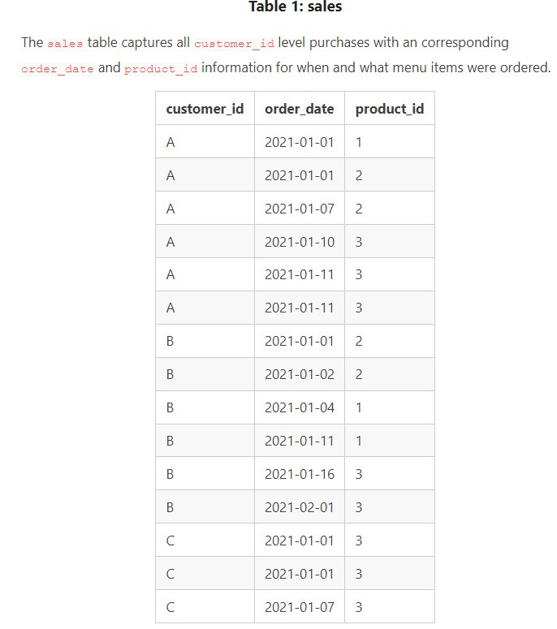
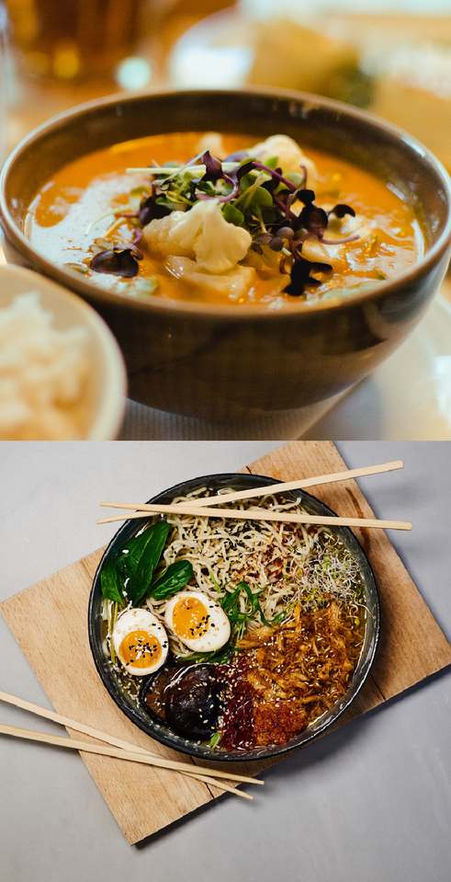
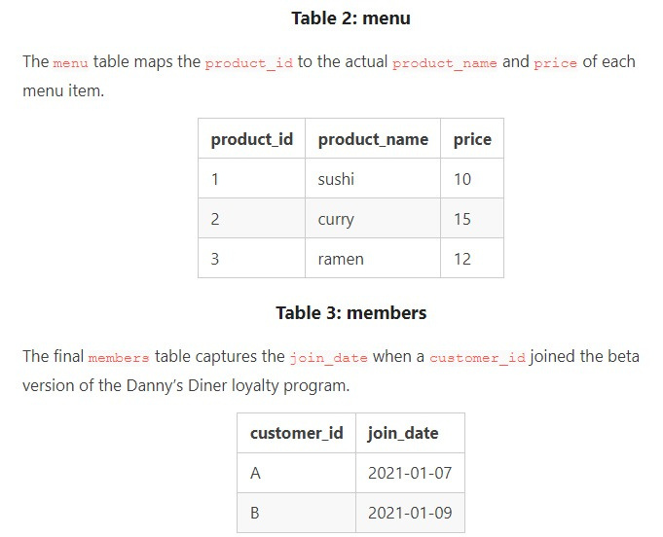
TABLES

Slide 6
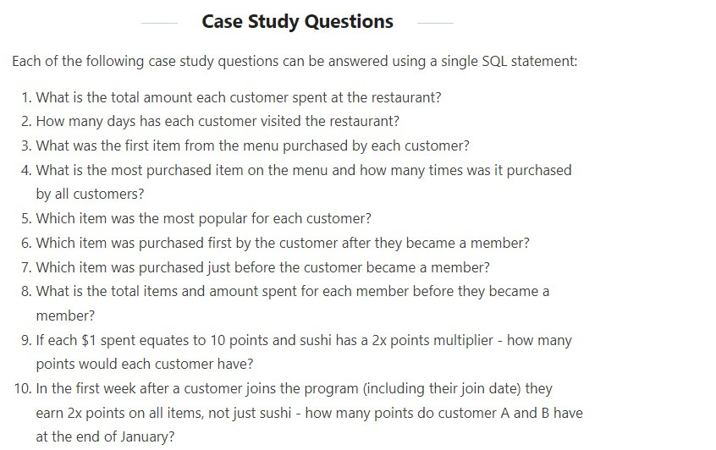
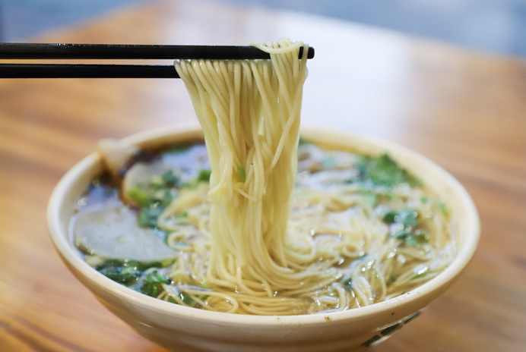
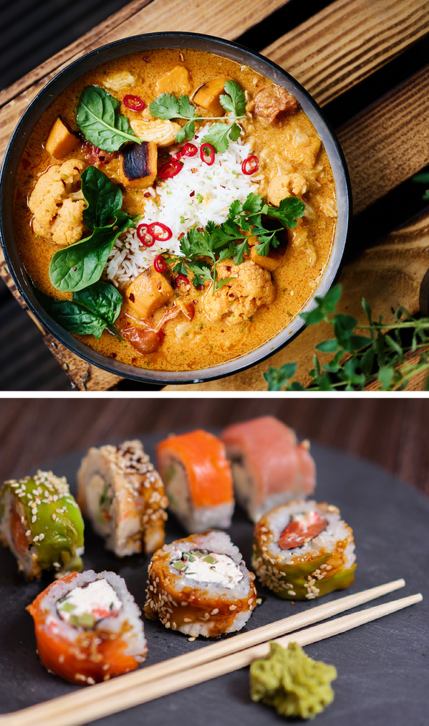

Slide 7
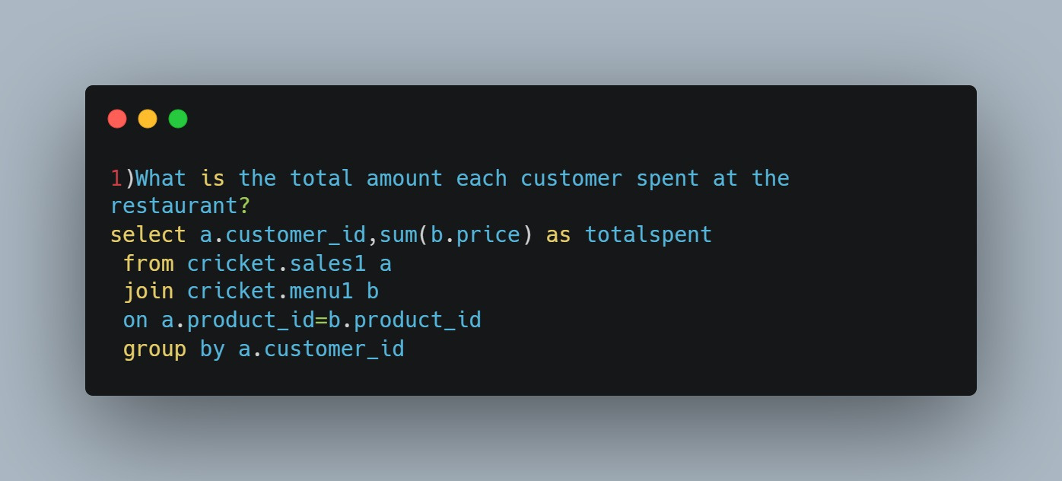

Slide 8
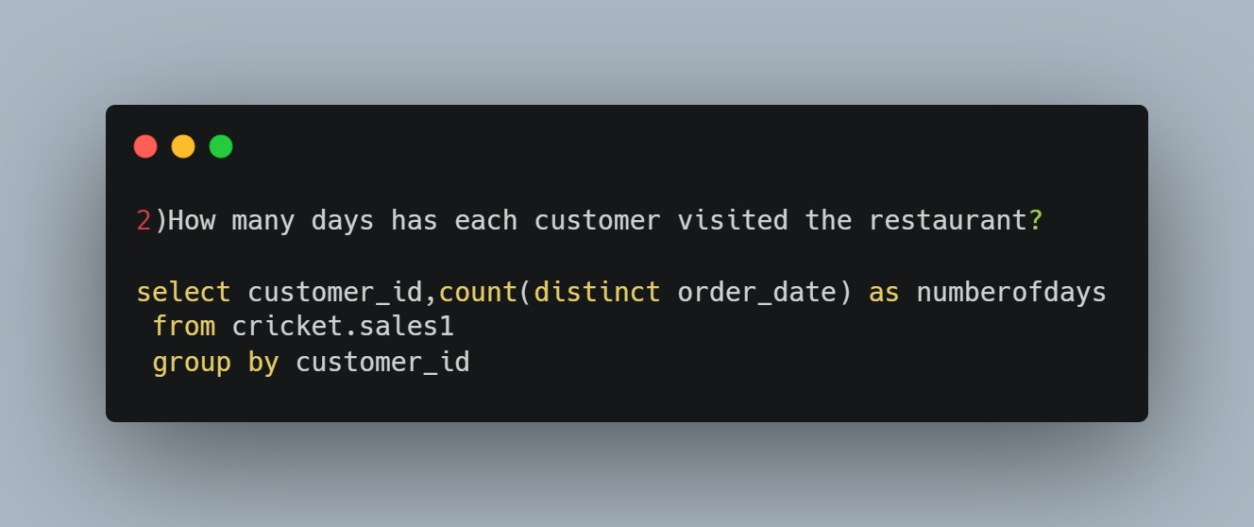

Slide 9
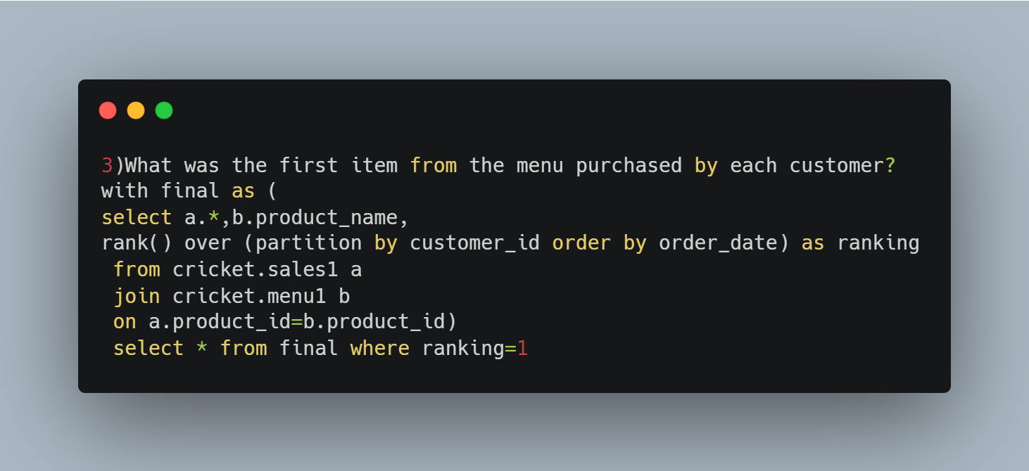

Slide 10
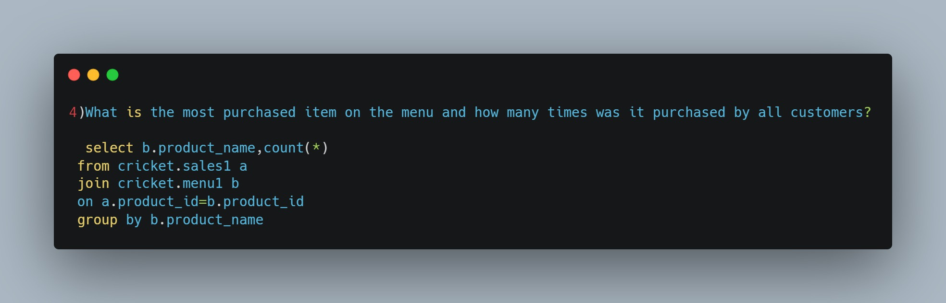

Slide 11
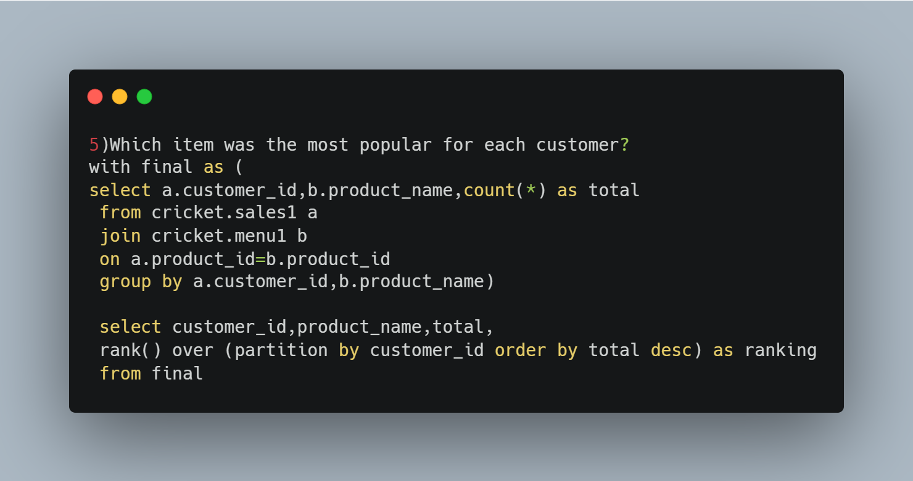

Slide 12
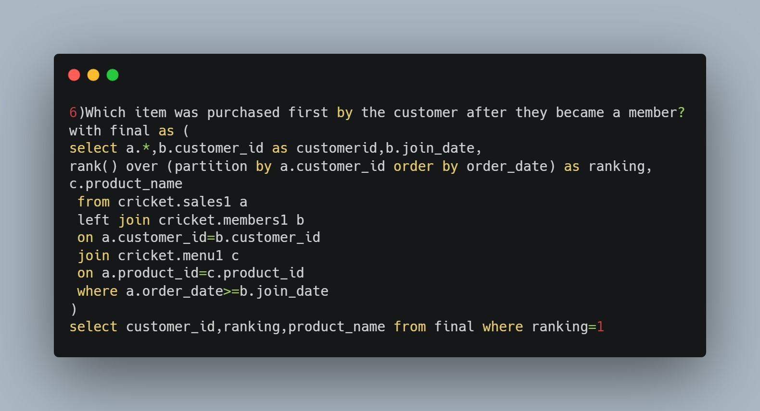

Slide 13
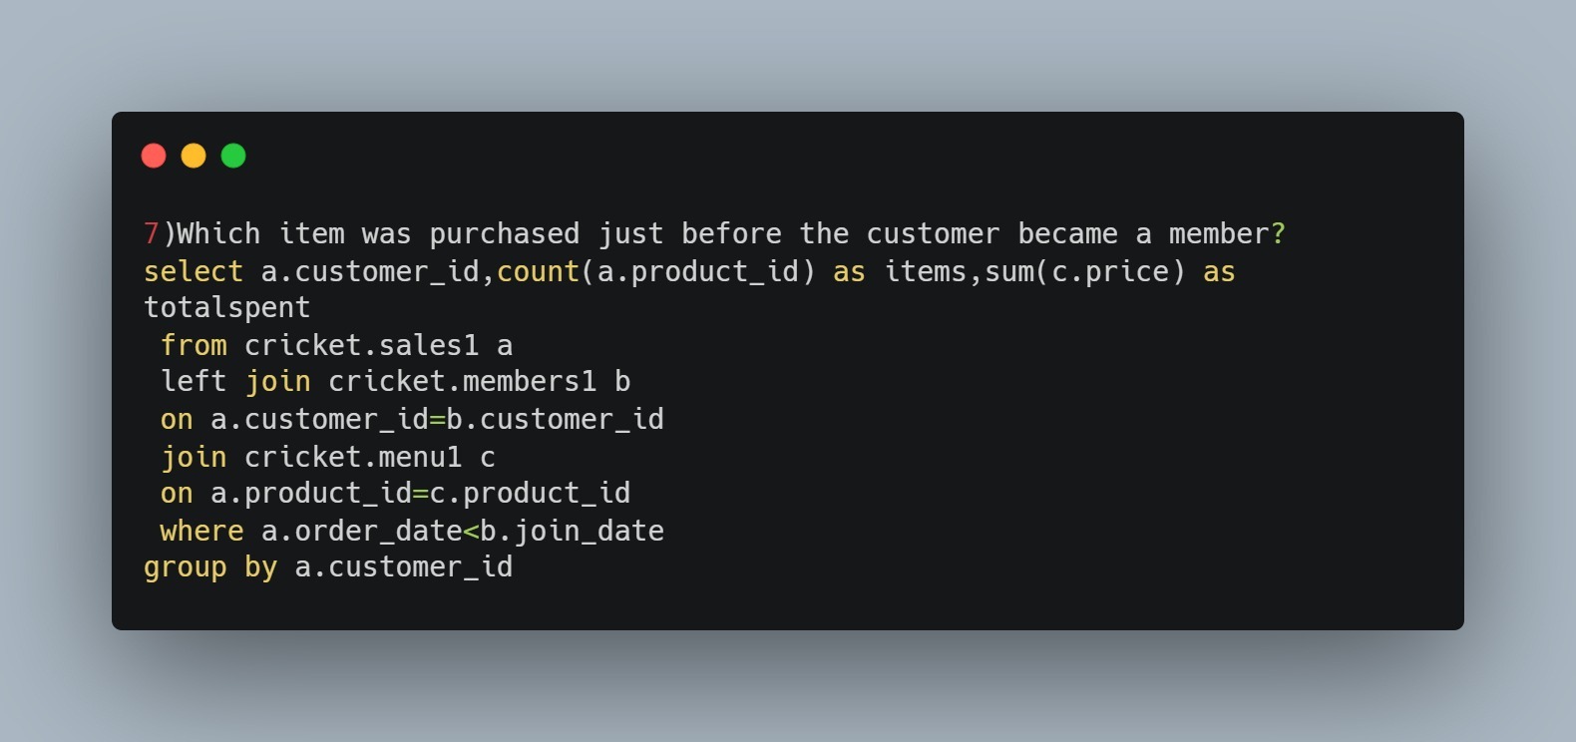

Slide 14
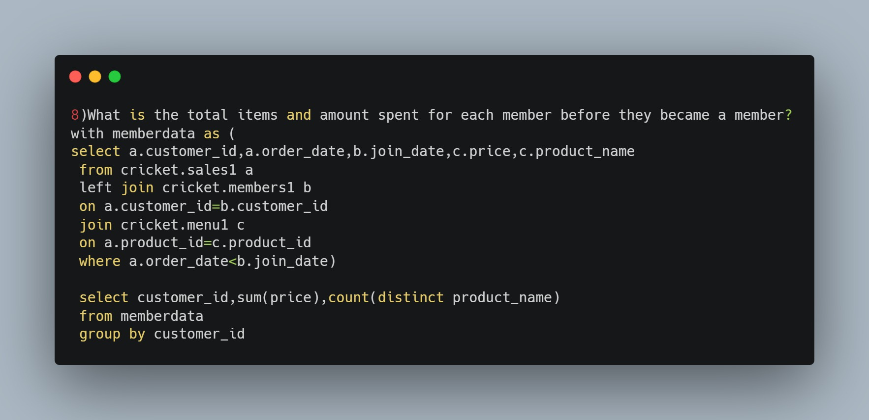

Slide 15
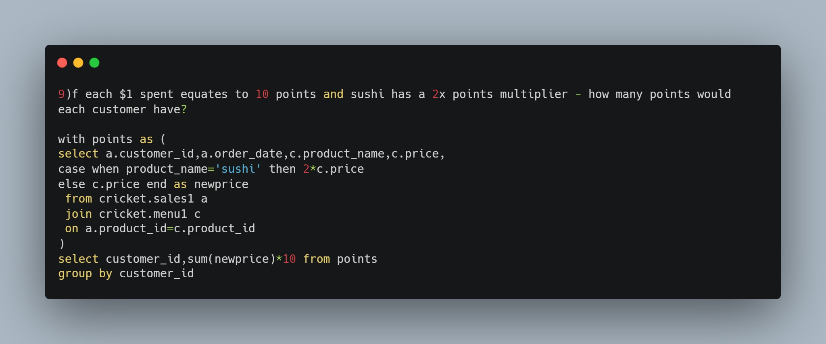

Slide 16
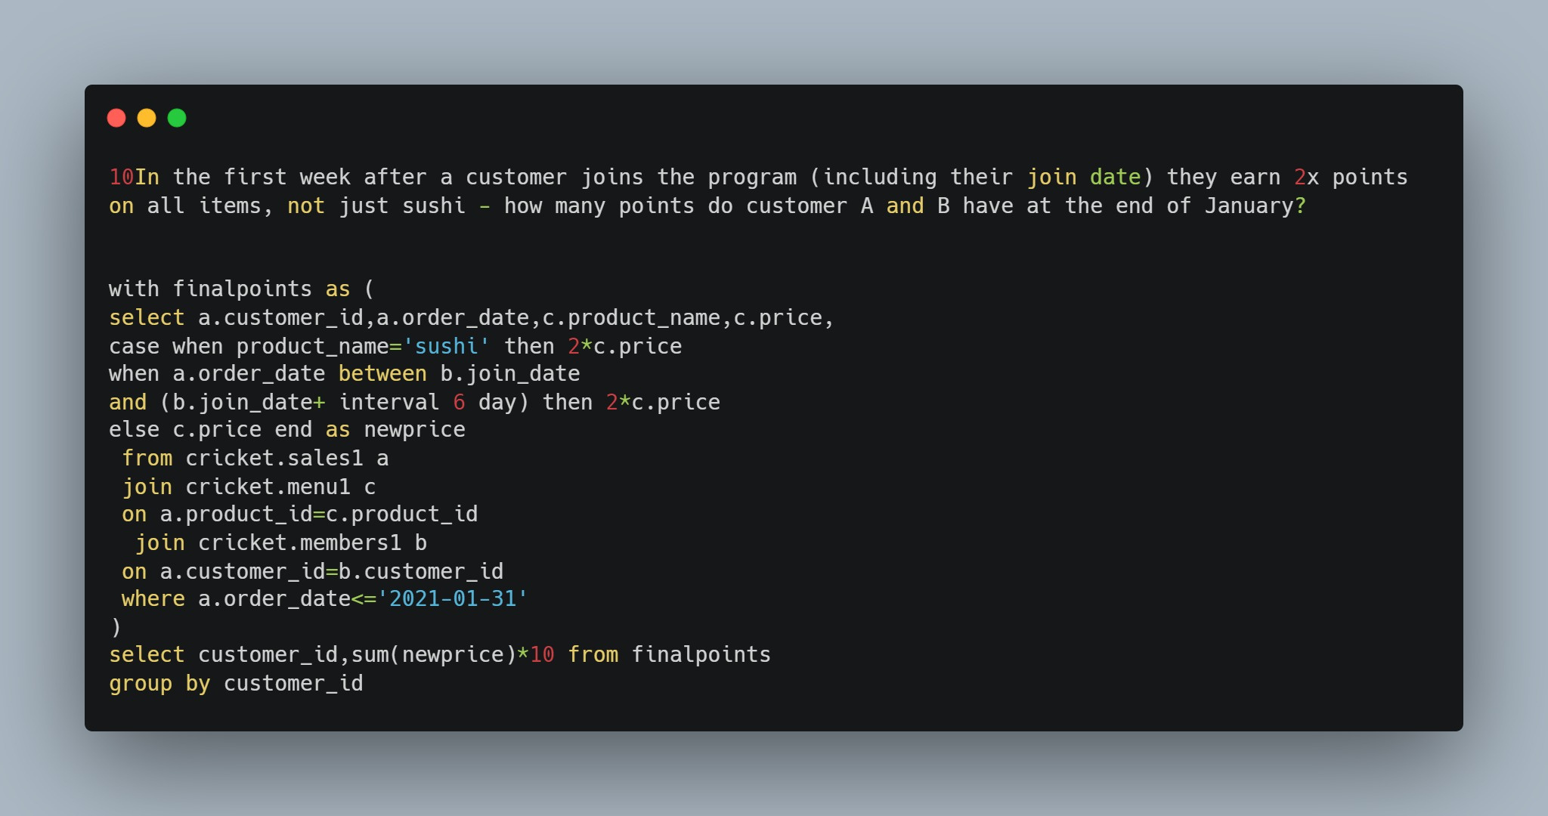

Slide 17
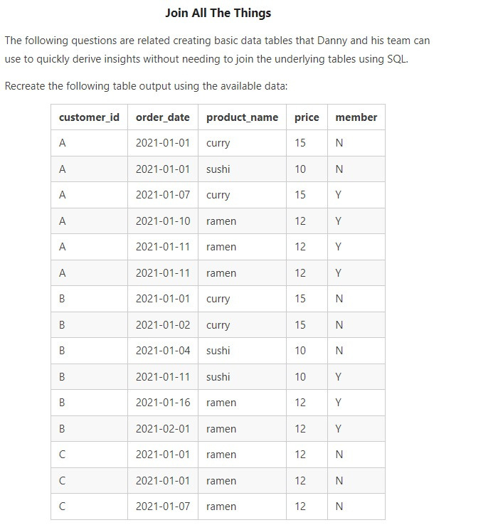
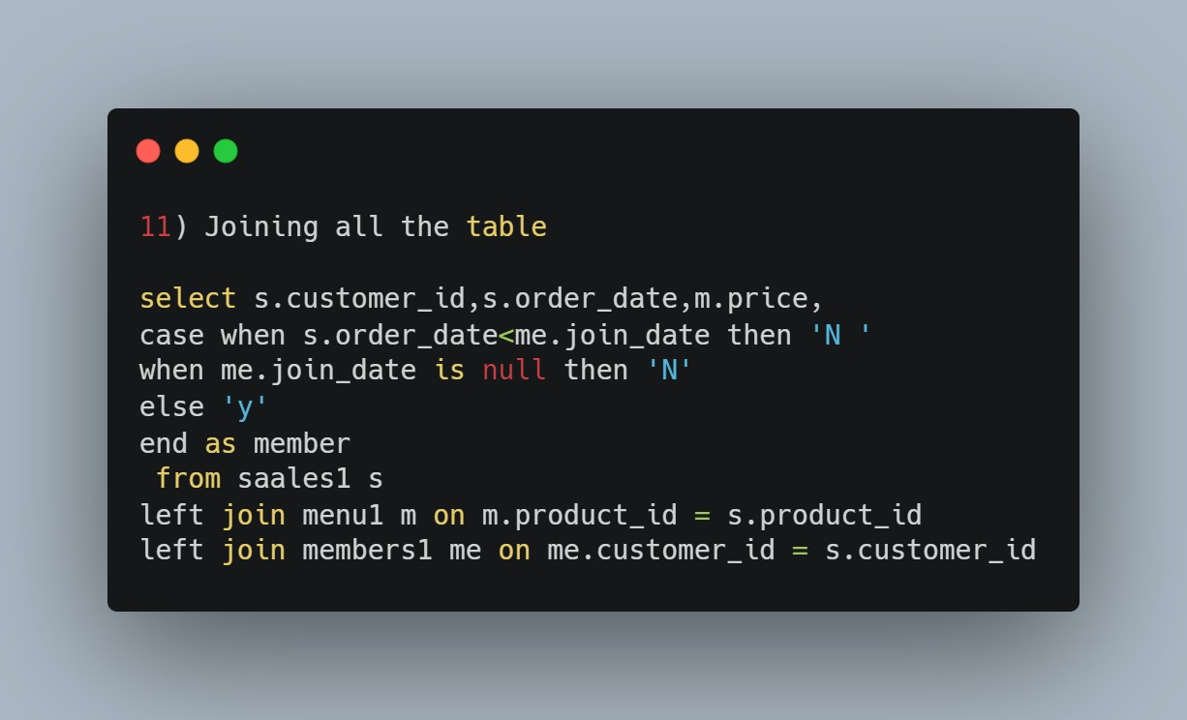

Slide 18
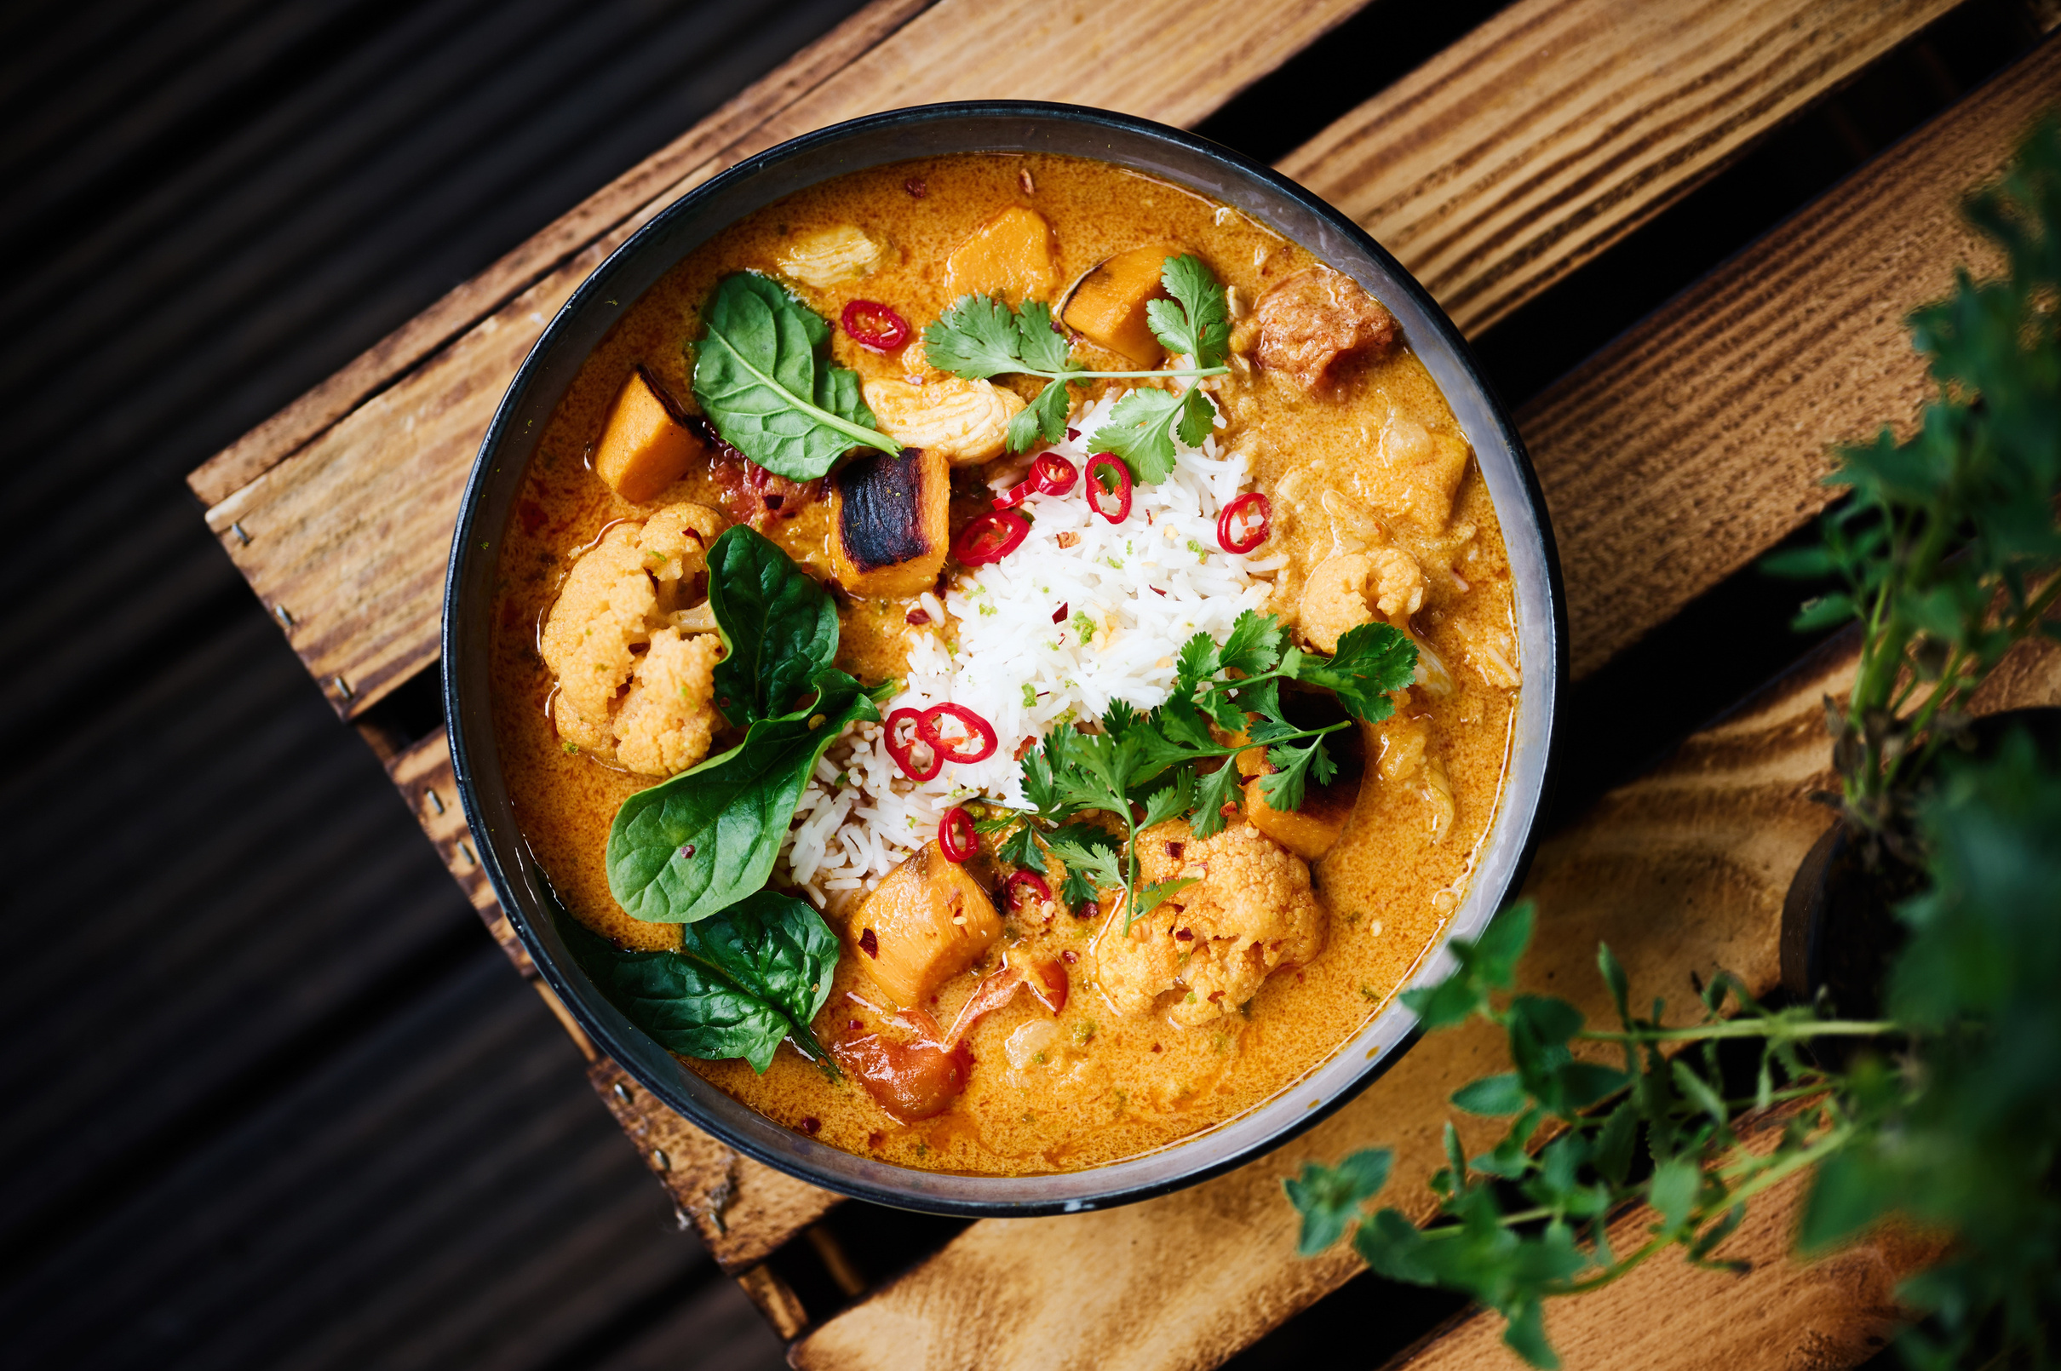

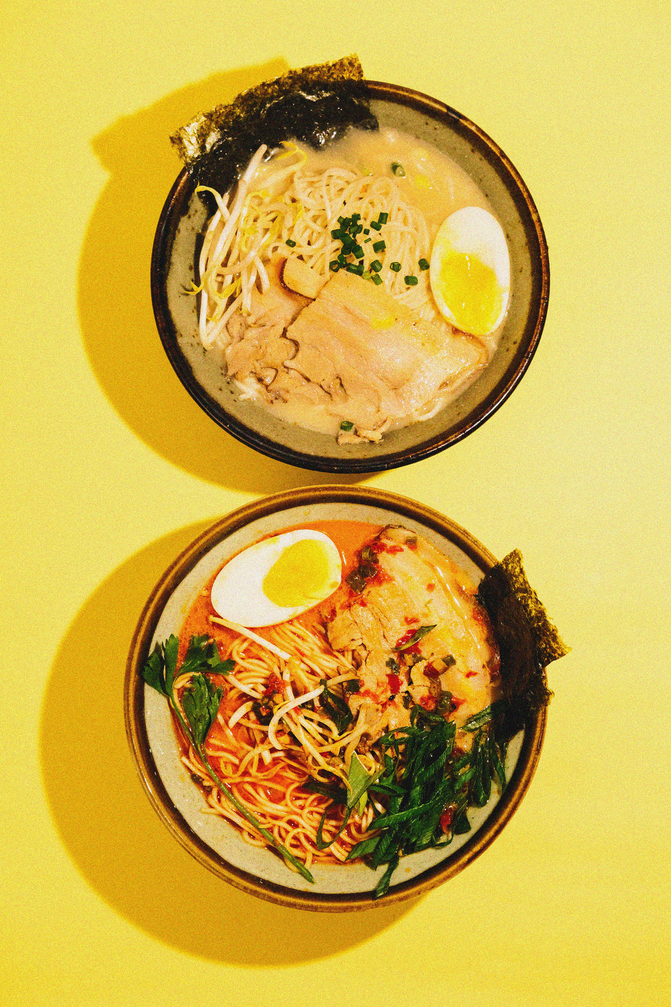
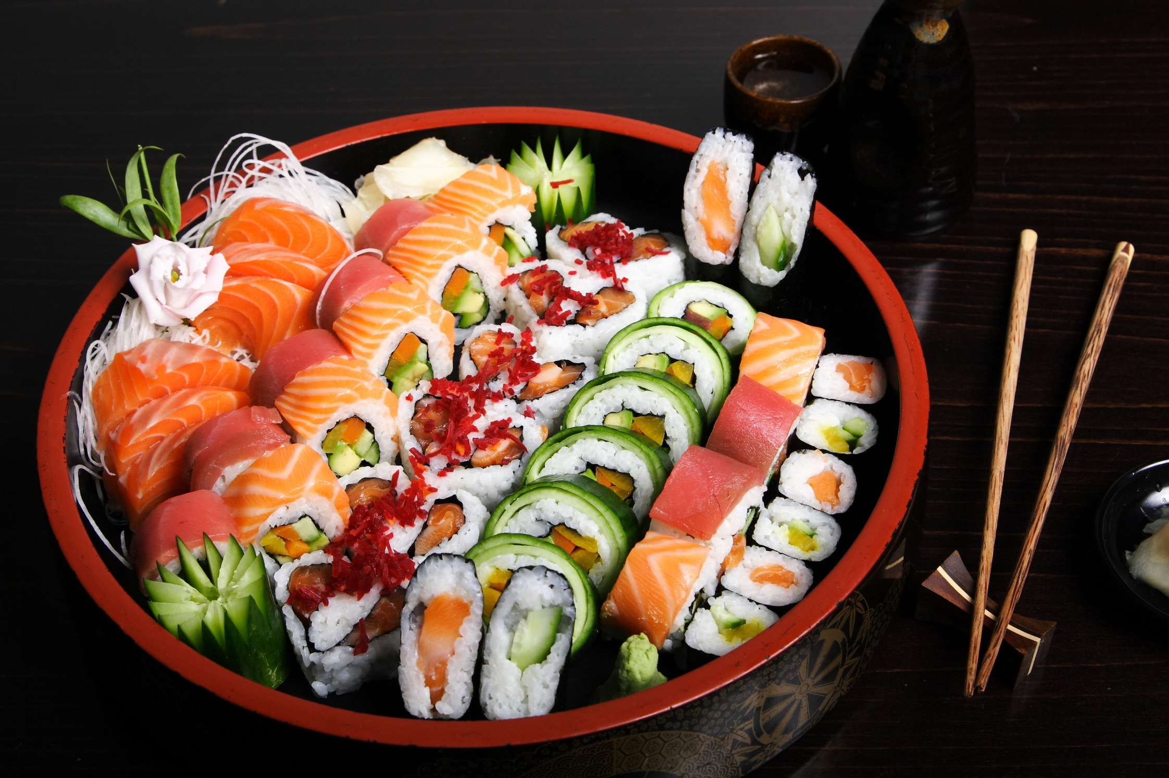
KeyPoints
Function used in this case study
1.CTE(common table expression 2.Group by, Aggregate function
3. Joins
4.Window function - Ranking
5.Case with clause

Slide 19
Case studies Insights
Customer A spent maximum amount in the restaurant Customer B is the frequent customer visited restaurants Ramen is the most purchased item on the menu Customer B has maximum points that is 940 points in total

Slide 20
